Slide 1
Sea-ice and Freshwater-marine coupling: freshwater-marine interaction and integration of modeling and observational data
Jens Ehn (Team 1) and Paul Myers (Team 6)

Slide 2
Integration Aspects
Summary of Observational Work (moorings, field campaigns, …)
Overview of NEMO and experiments
Interaction and Integration
NEMO – BaySys Mooring Comparisons + Baseline Study
Present Day
Seasonal Circulation Patterns
Atmospheric Vorticity and Circulation
NEMO Model Fields for Other Team Studies
Estuarine Model Boundary Conditions
Model Fields for Ecosystem Studies
Future: Relative roles of Climate Change and Regulation
Simulated Evolution
Freshwater Budget
Biogeochemical Evolution (linked to freshwater-marine changes)

Slide 3
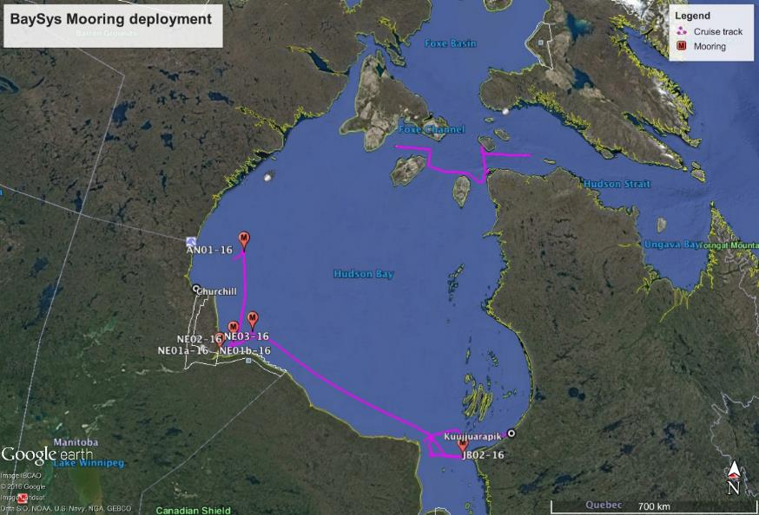
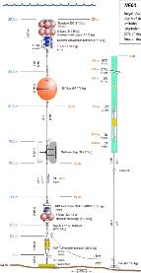
Mooring Program
1 x outer Churchill Estuary
2 x outer Nelson Estuary
1 x inner Nelson Estuary
1 x James Bay mouth
Notes:
Main project Sep 26-Oct 4 (southern track)
Opportunistic water sampling from Oct 4-Oct 12 (northern track)

Slide 4
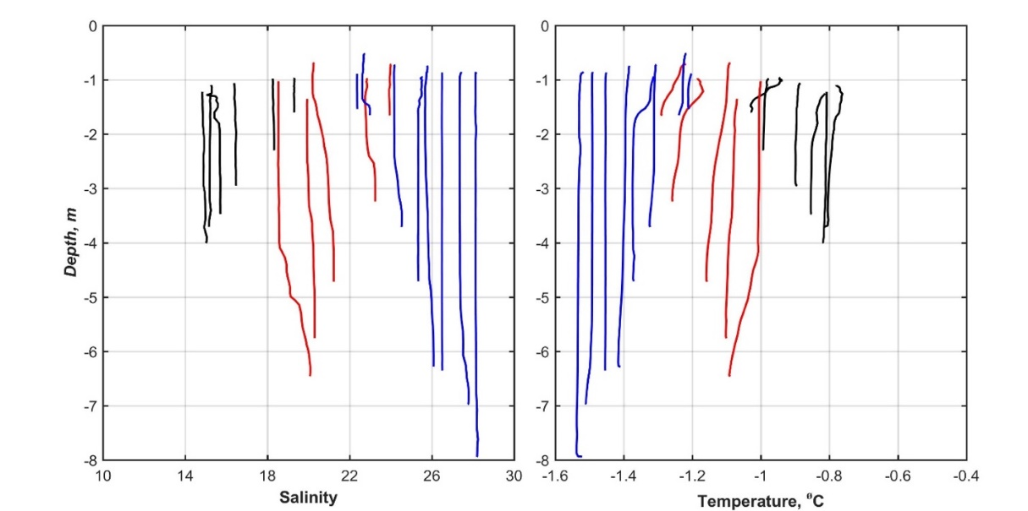
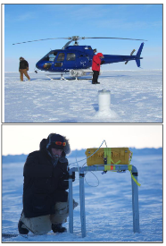
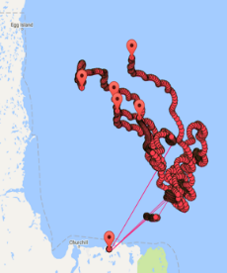
Winter Estuary Program
Early Feb 2017: Mobile ice helicopter work in Churchill E.
Retrieve marine end-member samples from Churchill Estuary

Slide 5
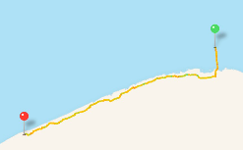
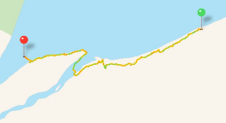
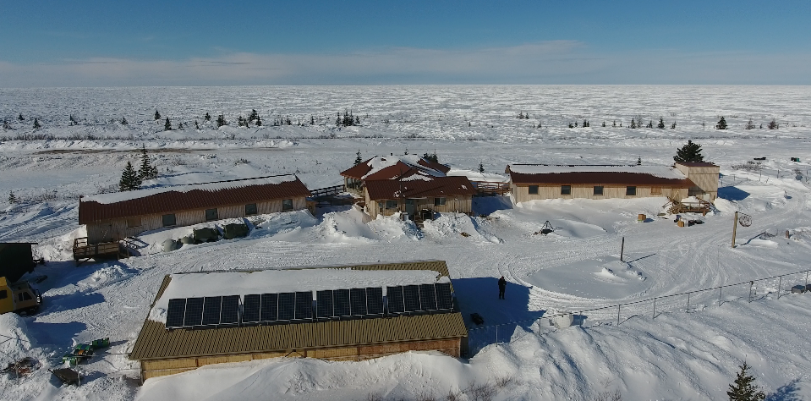
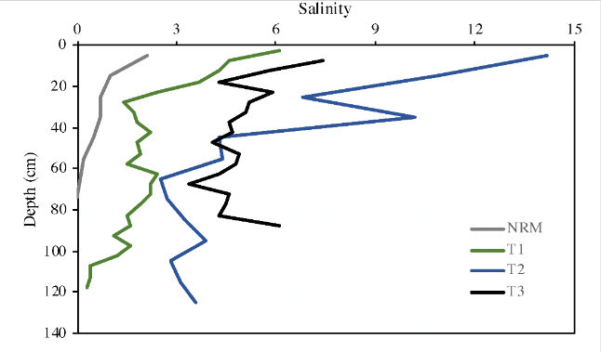
Winter Estuary Program
Late Feb-May 2017: Three ice camps in Nelson E. (Nanuk)
Characterizing the Nelson River plume
Directly support Teams 1, 3, 4, 5

Slide 6
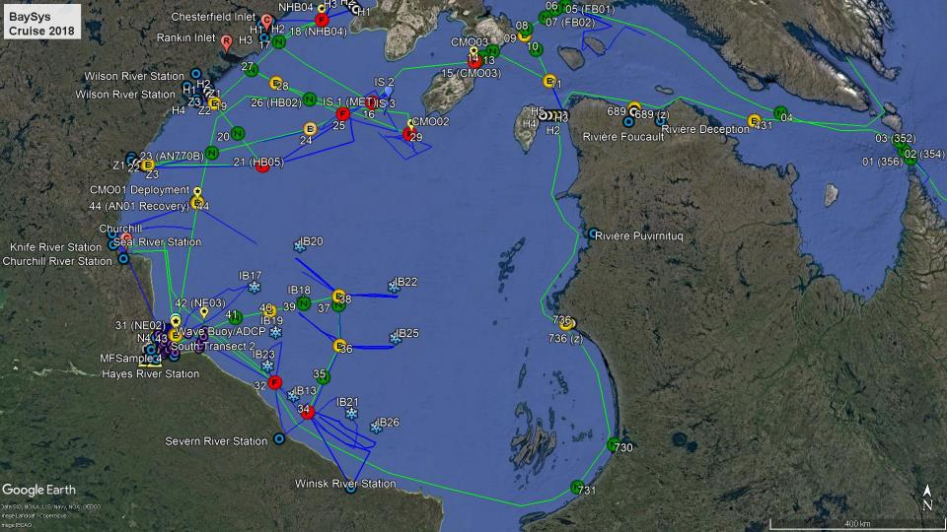
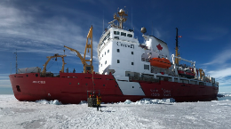
Spring Program

Slide 7
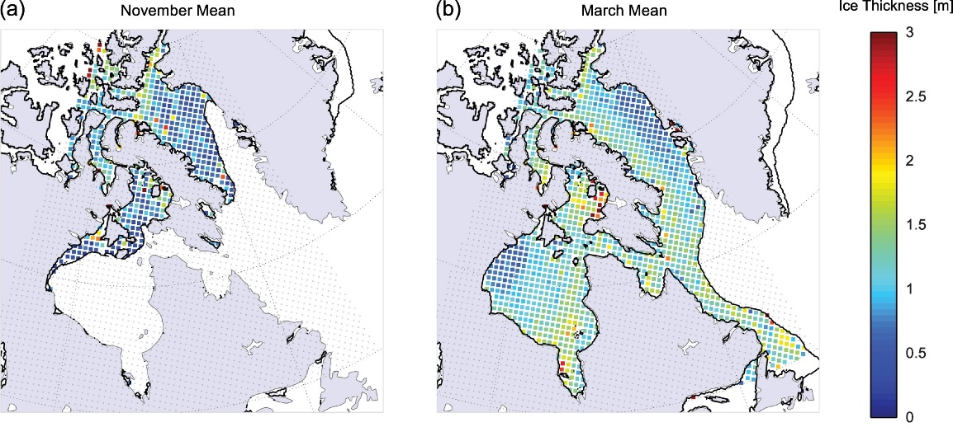
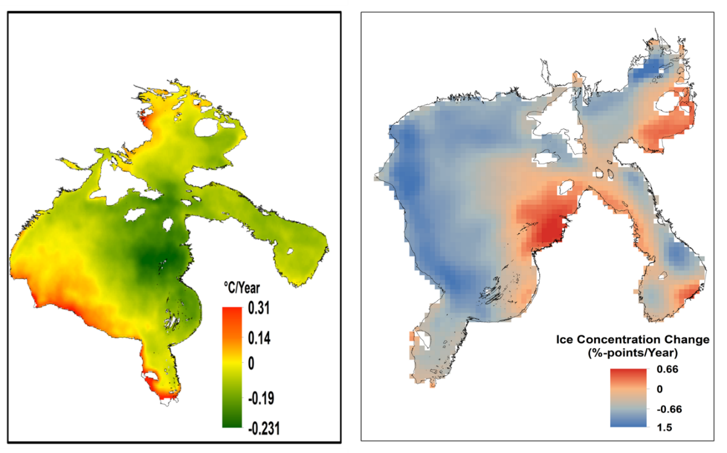
Remote sensing
‘Climatological’ mean sea ice thickness as observed by ICESat GLAS, Cryosat-2 and SMOS in (a) November, and (b) March, for 2003–2016. Bold lines give the mean ice edge (20% ice concentration) for these periods. Taken from Landy et al. (2017)
SST trend 2008-2018
SIC trend 2008-2018
Trends in mean sea surface temperature (for open water period) and Ice concentration from 2008 to 2018.

Slide 8
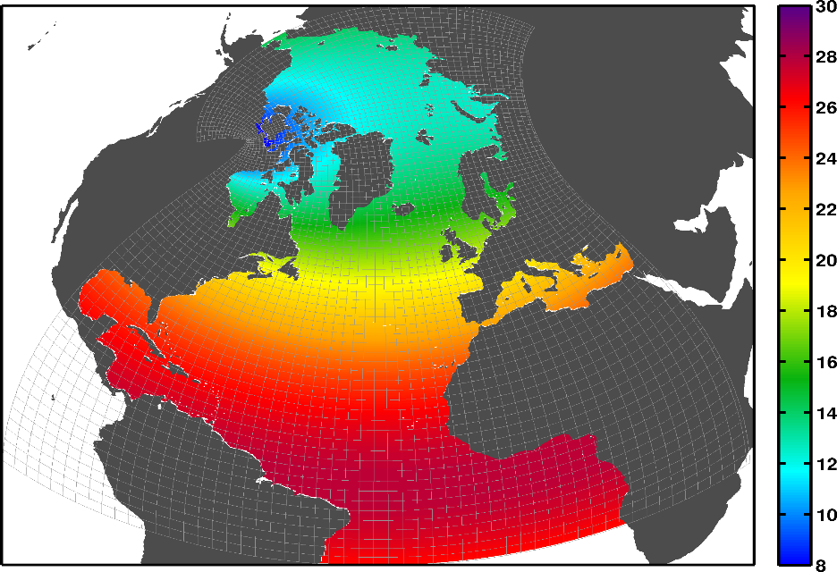
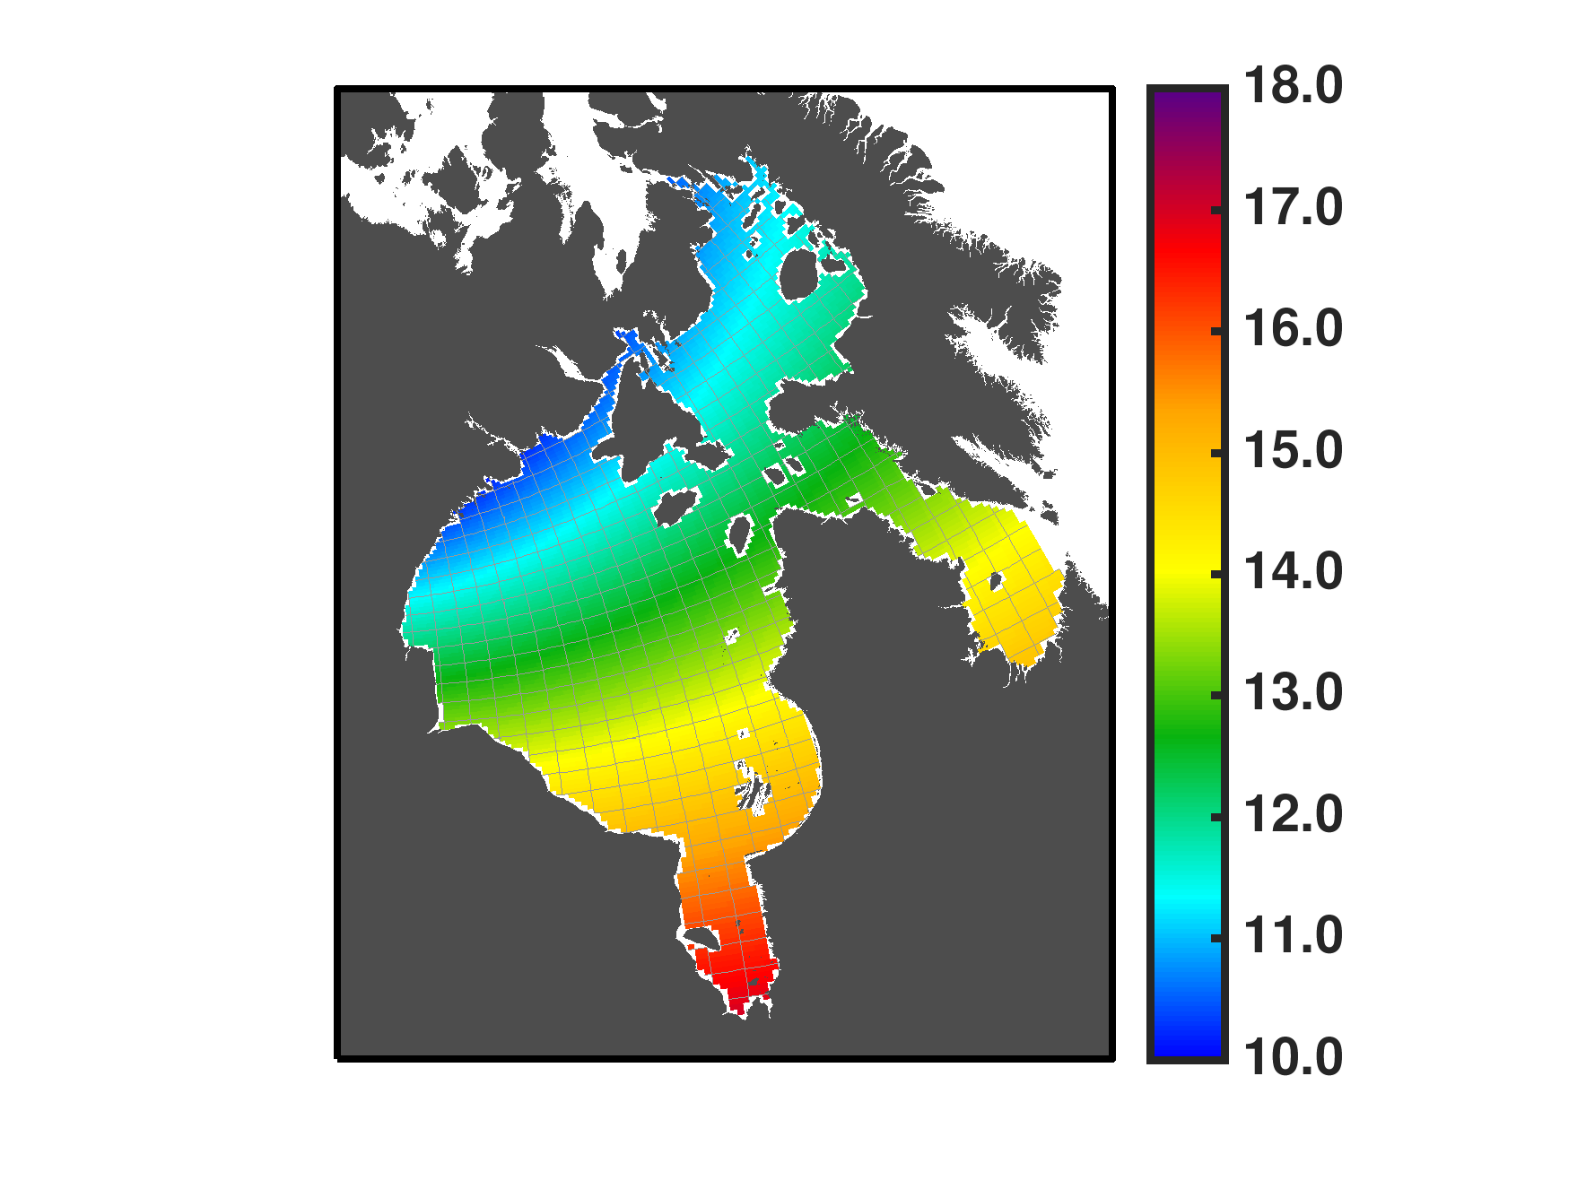
ANHA NEMO Configuration in the HBC
ANHA4
Model: NEMO 3.6 (ocean)
LIM2 + EVP (sea ice)
Resolution: ¼ degree
544x800x50 grid points
~ 10 – 15 km within Hudson Bay
~20 hours for 2 years on 256 processors on Compute Canada Graham system
Atmospheric forcing:
Fluxes from Bulk Formulae
Surface temperature, humidity
Zonal and Meridional Winds
Precipitation (including snow)
Radiation (SW & downwelling LW)
Runoff:
In HBC - HYPE (Team 2)
In Arctic - AHYPE(Team 2)
Greenland – RACMO (inc. icebergs)
Atlantic Domain - CCCMA
NO temperature & salinity restoring
Tides: 9 Constituents
K1, K2, M2, M4, N2, O1, P1, Q1, S2
Hudson Bay Complex Zoom

Slide 9
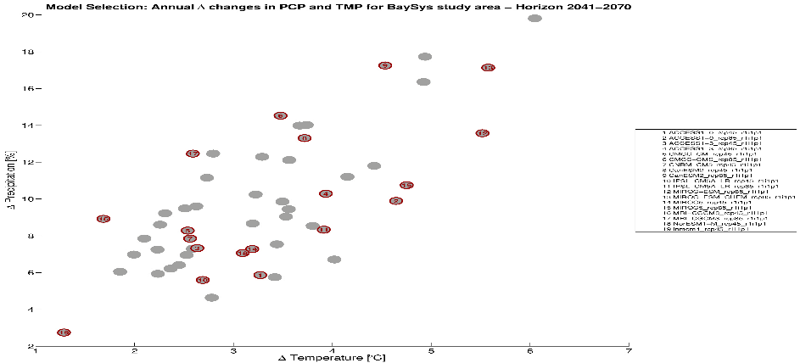
Experiments labelled in red also included the BLINGv0-DIC biogeochemical model
9
71 simulation ensemble
19 selected for Hudson Bay
5 for NEMO
Bias Corrected Forcing Fields Provided by Ouranos
Historical Control Future
ERA-Interim
MIROC
MRI-CGCM3
GFDL-CM3
MIROC Regulated RCP 4.5
MIROC Naturalized RCP 4.5
MIROC Regulated RCP 8.5
MIROC Naturalized RCP 8.5
MRI-CGCM3 Regulated RCP 4.5
MRI-CGCM3 Naturalized RCP 4.5
MRI-CGCM3 Regulated RCP 8.5
MRI-CGCM3 Naturalized RCP 8.5
GFDL-CM3 Regulated RCP 4.5
GFDL-CM3 Naturalized RCP 4.5
1980
2005
2006
2070

Slide 10
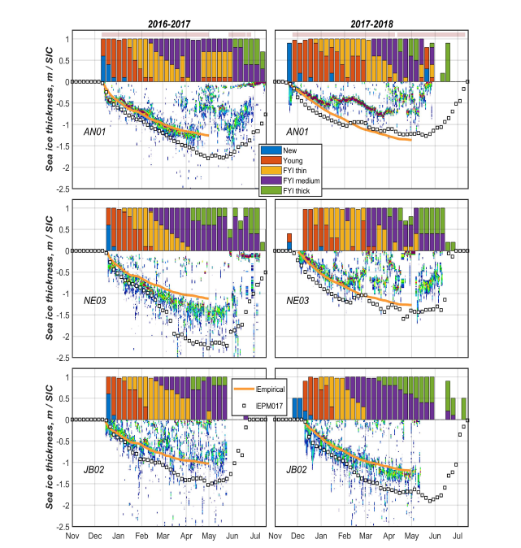
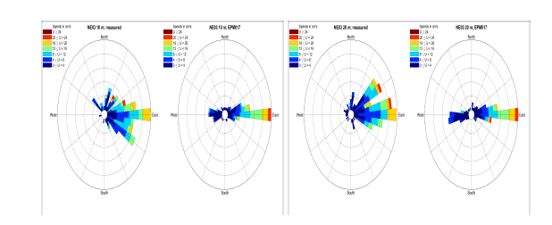
NEMO – BaySys Mooring Comparisons

Slide 11
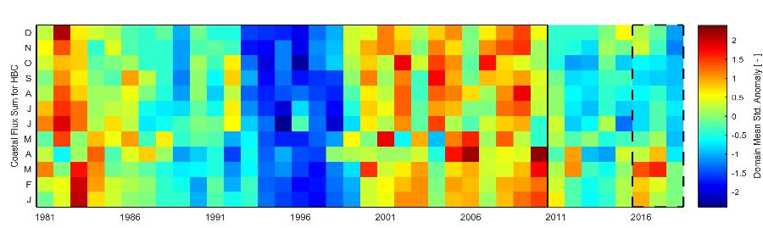
Hudson Bay Complex 2016-2018 baseline evaluation, Part I: Atmospheric and river discharge conditions J. V. Lukovich, Andrew Tefs, Shabnam Jafarikhasragh, Clark Pennelly, Paul G. Myers, Tricia A. Stadnyk, Kevin Sydor, Karen Wong, Michael Vieira, David Landry, Julienne C. Stroeve, D.G. Barber
Objectives/ relation to other teams:
To provide context for atmospheric and river discharge conditions within the Hudson Bay Complex for the 2016 to 2018 BaySys timeframe relative to the 1981-2010 historical climatology, as "input" to the NEMO model.
Atmospheric and river discharge conditions for BaySys timeframe:
2016: warm marine conditions throughout the annual cycle, high wind speeds in spring, high SLP in fall, high overland precipitation in November, high river discharge in JFM
2017: warm marine conditions in January, high wind speeds in November, minimum SLP in February and reversals in fall, high precipitation in January, October, and November, high river discharge in March and April.
2018: cold and windy conditions throughout the annual cycle, SLP reversals in JFM, low precipitation, lower than normal river discharge from April to December.
Monthly SLP anomalies
Monthly river discharge anomalies
Spatial information/distributions found in Supplementary material.

Slide 12
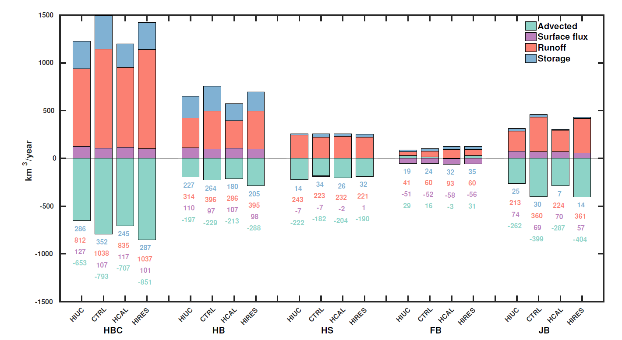
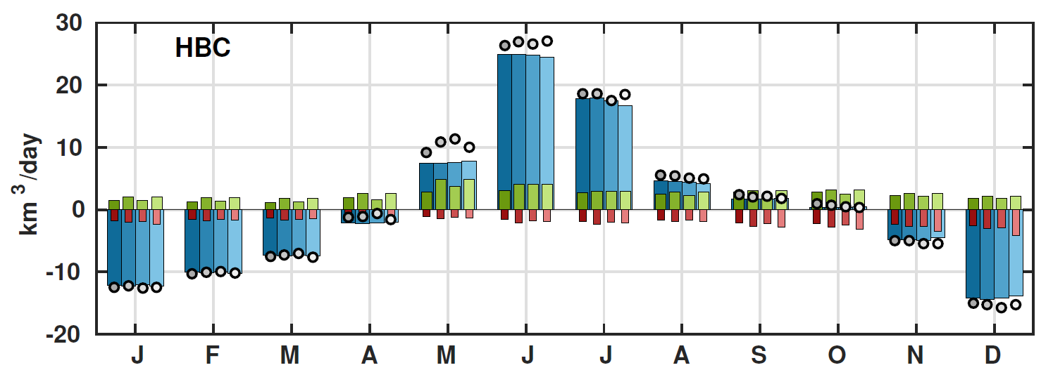
Freshwater (FW) budgets
Annual FW budget for the HBC and its subregions (right)
Seasonal FW budget for the HBC (below)
Shading indicates
different experiments
Green: river
Blue: surface fluxes
Red: advected FW
Circles: FW storage

Slide 13
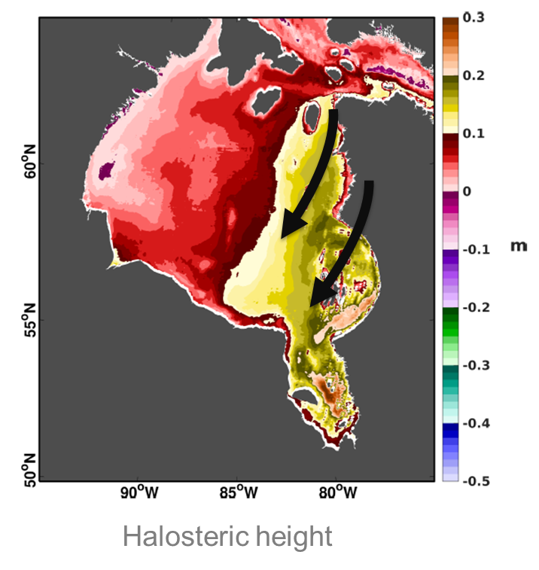
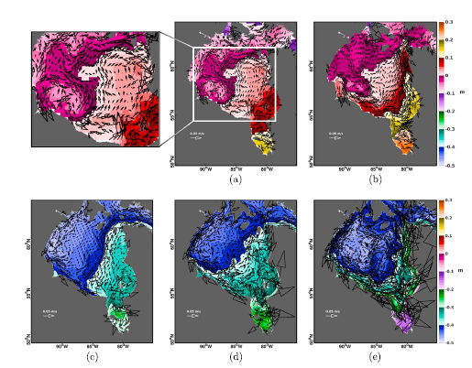
In summer, the mean circulation of the bay is not cyclonic but consists of multiple small cyclonic and anticyclonic features, with the mean flow directed through the center of the bay
A decrease in salinity, due to river runoff in the spring and summer lead to higher sea surface heights in the east compared to the west
Combined with anticyclonic wind stress, results in this seasonal flow reversal

Slide 14
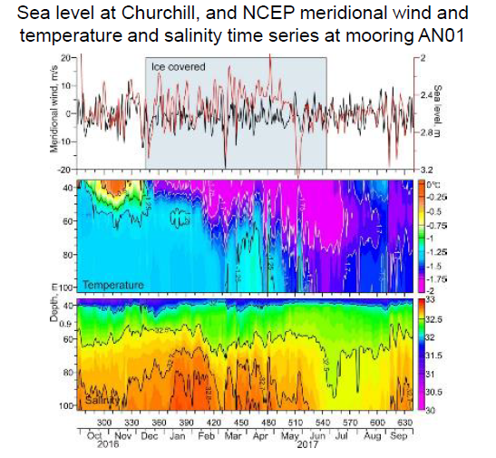
Dmitrenko et al., Atmospheric forcing facilitates cross-shelf exchange in Hudson Bay

Slide 15
Shared NEMO Model fields for Local Models and EcoSystem Studies
Jens Ehn (T1) - for boundary conditions for Nelson Estuary Model and James Bay model.
Greg McCullough (T1) - HBC freshwater budget and exchanges
Sarah Schembri (T3) – to drive Ichthyop model
Marie Pierrejean (T3) for benthic ecology question
Janghan Lee (T3) to assist with nutrient budget
Lucas Barbedo de Freitas (T3) to assist with phytoplankton bloom studies
David Capelle (T4) for input for carbon box model, as well as further studies of model biogeochemistry
Mohamed Ahmed (T4) for additional carbon studies

Slide 16
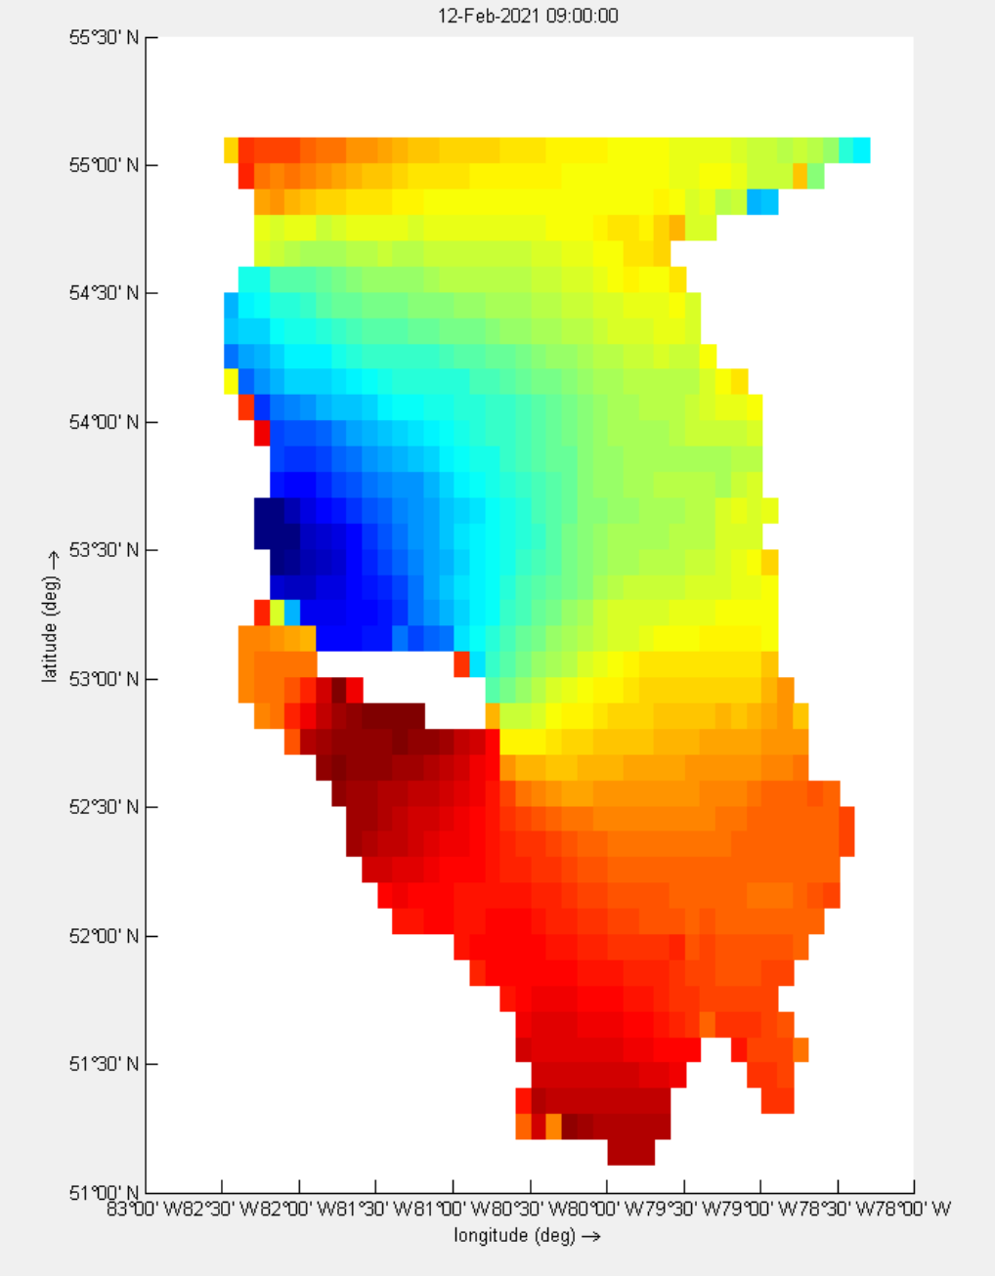
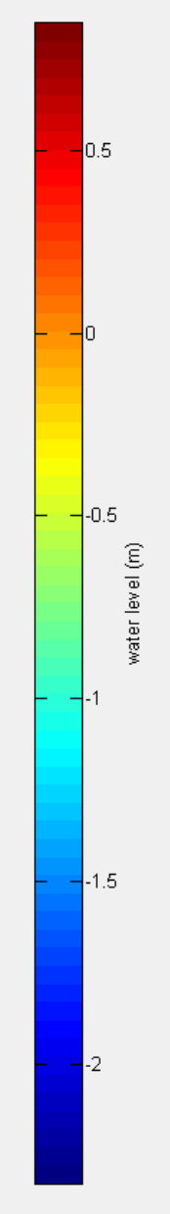
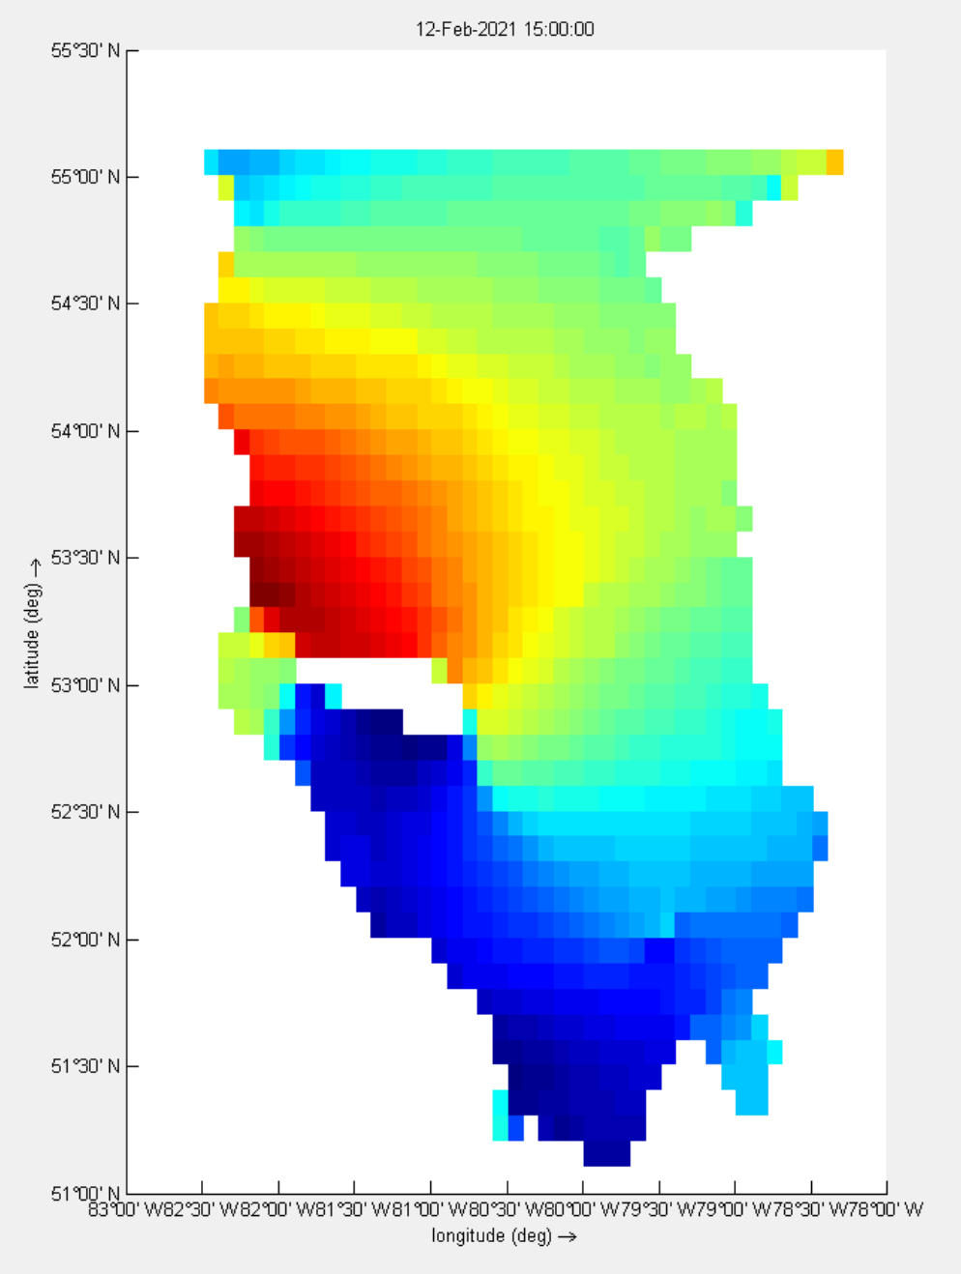
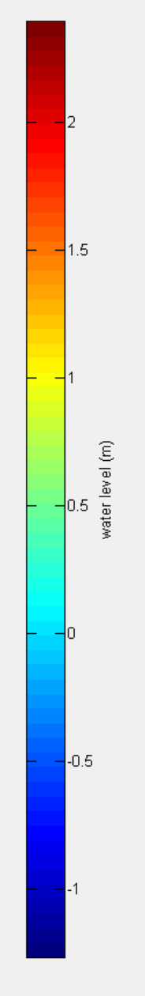
Coastal modelling
Delft3D test run for James Bay with GEBCO bathymetry and tides, no river runoff yet
9 am
3 pm

Slide 17
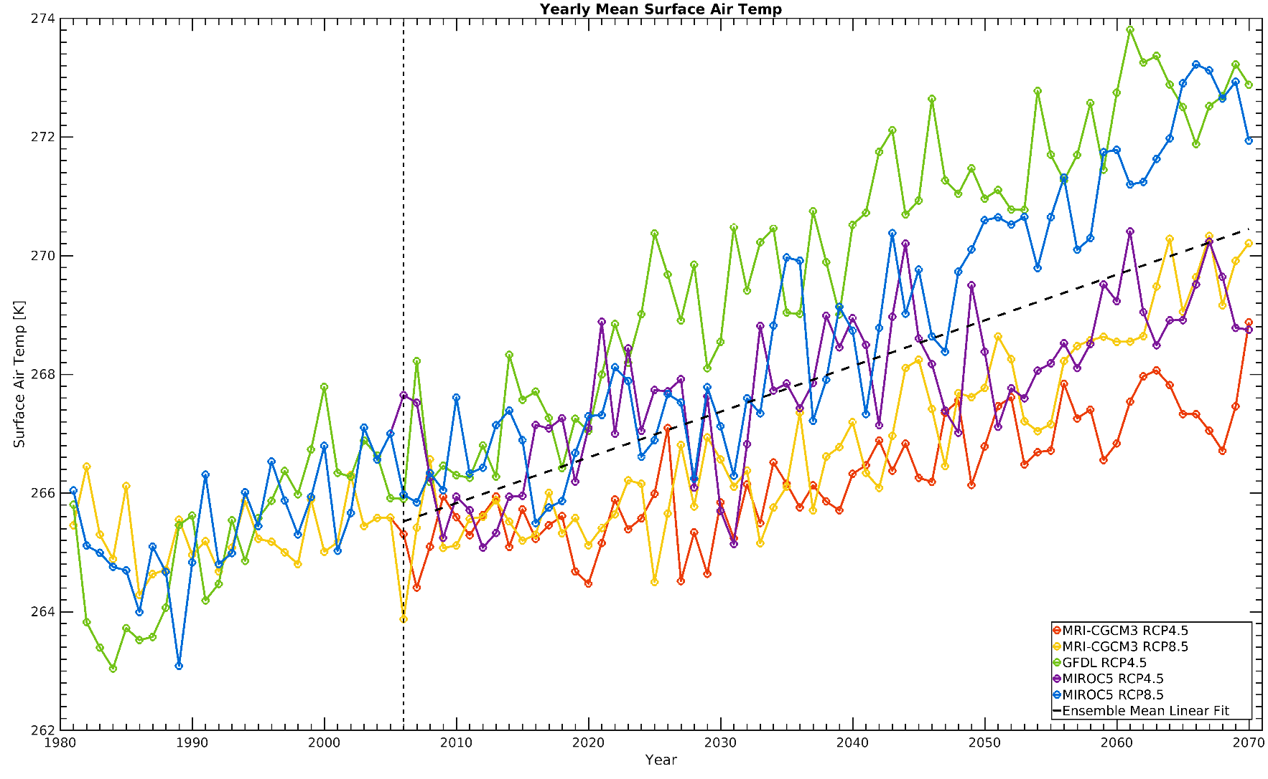
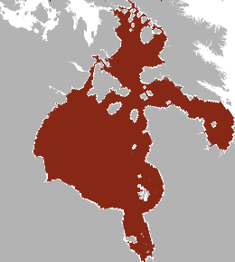
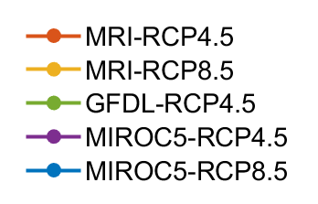
Atmospheric forcing
Annual mean surface air temperature
274
272
270
Surface air temp. [K]
268
266
264
262
1980 1990 2000 2010 2020 2030 2040 2050 2060 2070
Years

Slide 18
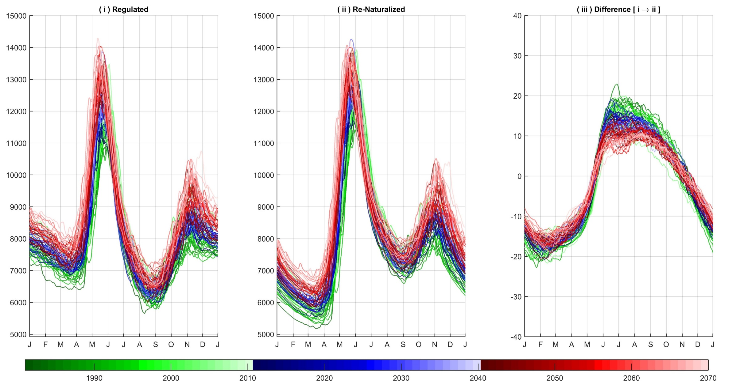
River runoff
Units?
Tefs et al., 2020, status

Slide 19
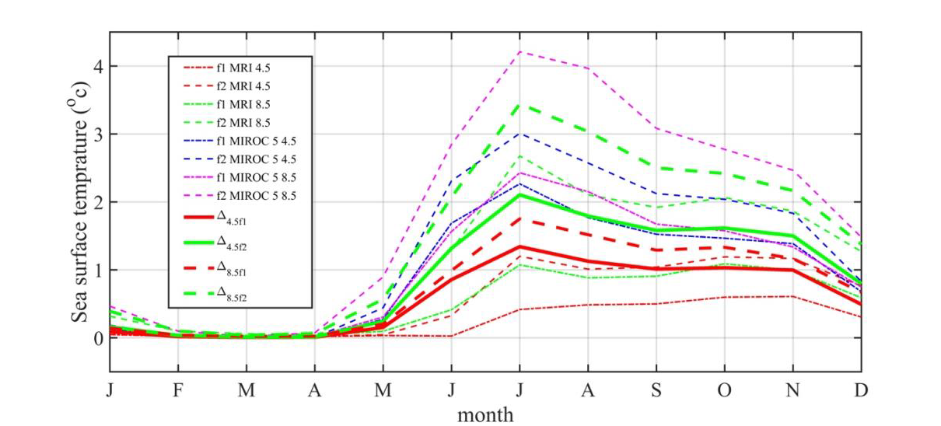
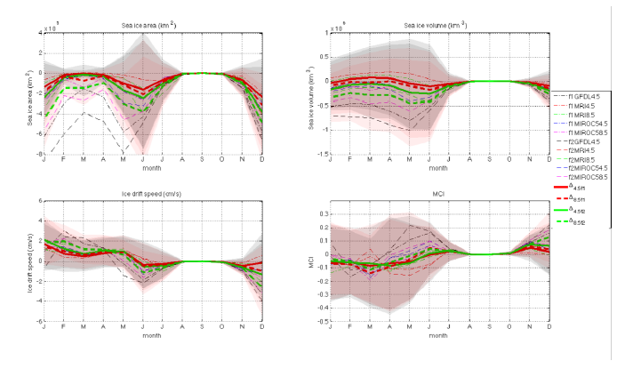
Temporal Analysis
f1(2021-2050 compared to 1981-2010)
Shading indicates uncertainty
f2(2041-2070 compared to 1981-2010)
Lukovich et al., 2021, in review

Slide 20
Climate Change vs Regulation Impacts
Percent climate change and regulation impacts for sea ice area, volume, mean sea ice drift speed and the meridional circulation index on monthly timescales
percent regulation impacts
f1(2021-2050 compared to 1981-2010)
Negative values indicate impacts that counteract combined climate change and regulation impacts
f2(2041-2070 compared to 1981-2010)
RCP8.5
Lukovich et al., 2021, in review

Slide 21
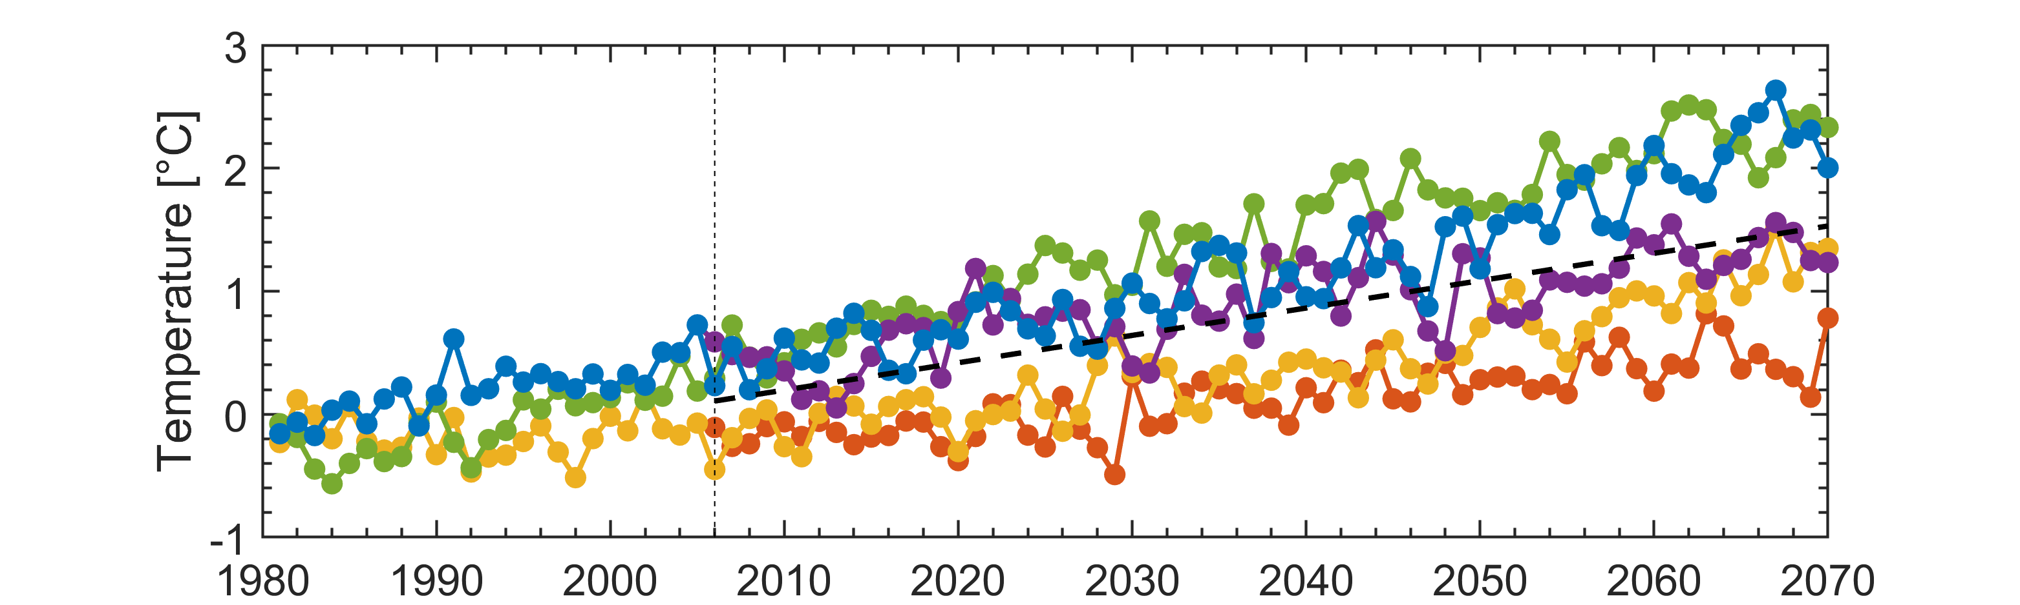

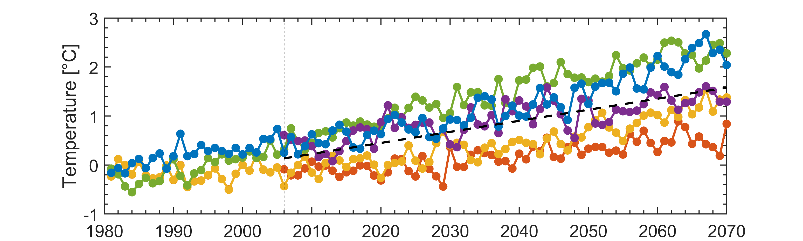
Ensemble mean ocean temperature increases by ~1.5°C between 2005 - 2070
Annual mean temperature over the Hudson Bay Complex
Naturalized
Little influence from river regulation
2006
Regulated
2006

Slide 22
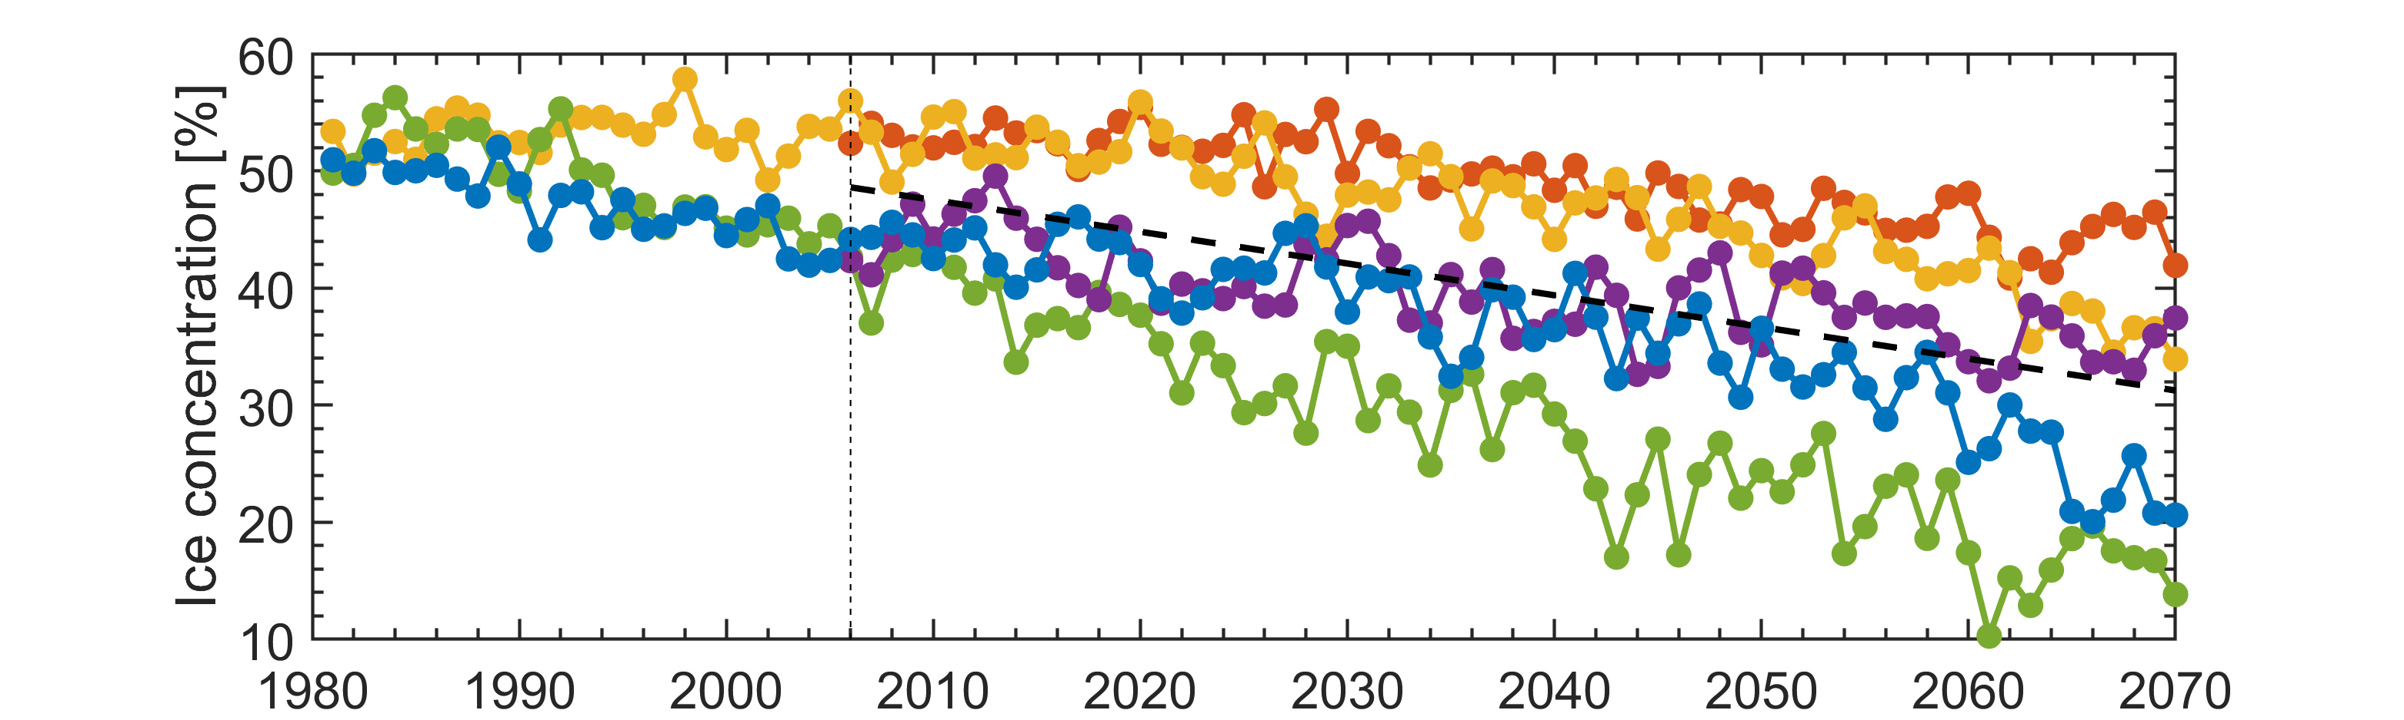
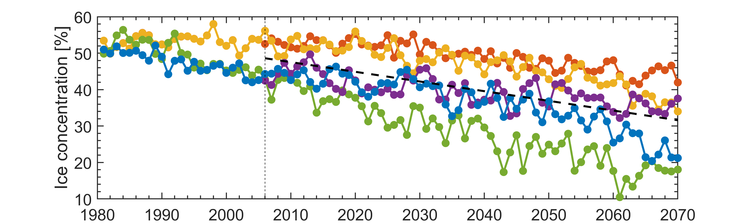
Ensemble mean sea ice concentration decreases by ~ 20% between 2005 - 2070
Annual mean sea ice concentration over the Hudson Bay Complex
Naturalized
Little influence from river regulation
2006
Regulated
2006

Slide 23
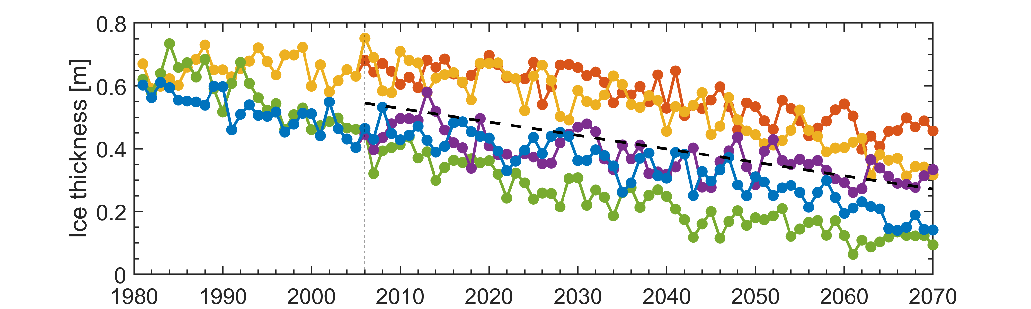
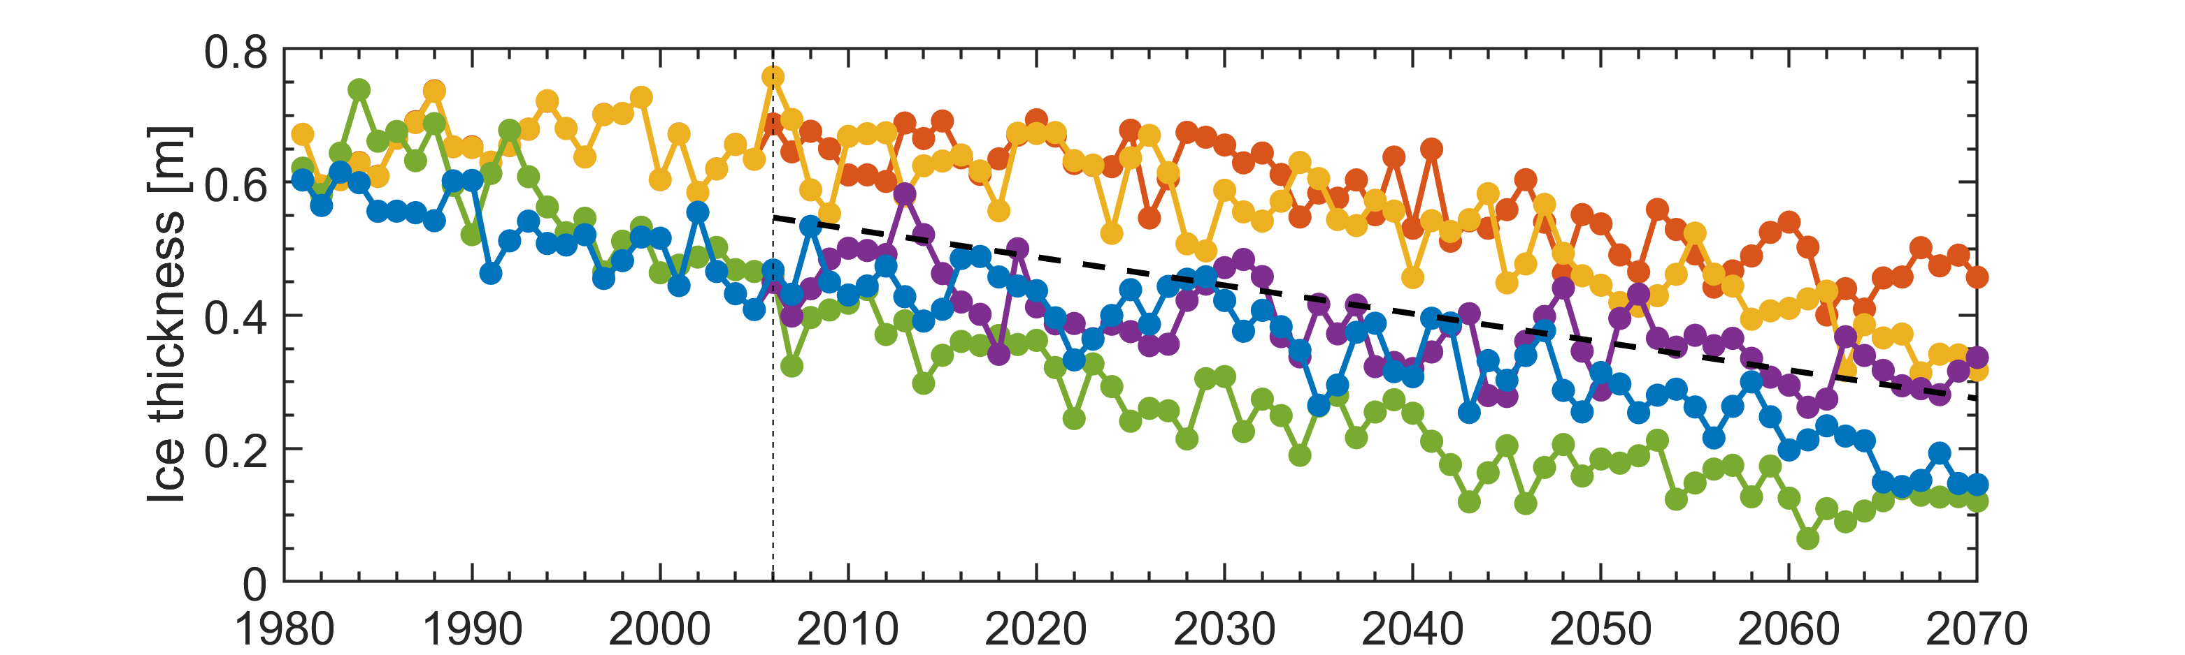
Ensemble mean sea ice thickness decreases by ~0.27 m between 2005 - 2070
Annual mean sea ice thickness over the Hudson Bay Complex
Naturalized
Little influence from river regulation
2006
Regulated
2006

Slide 24
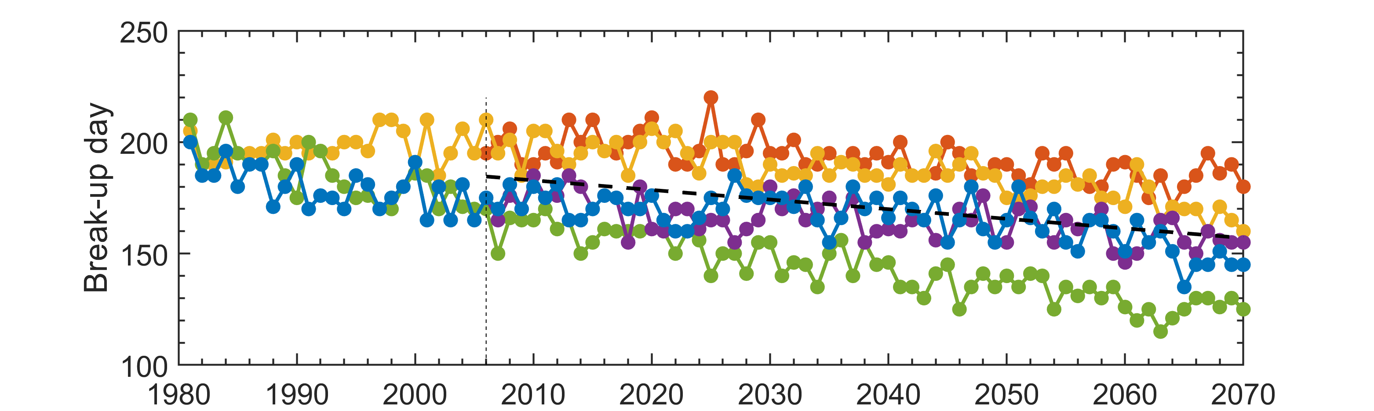
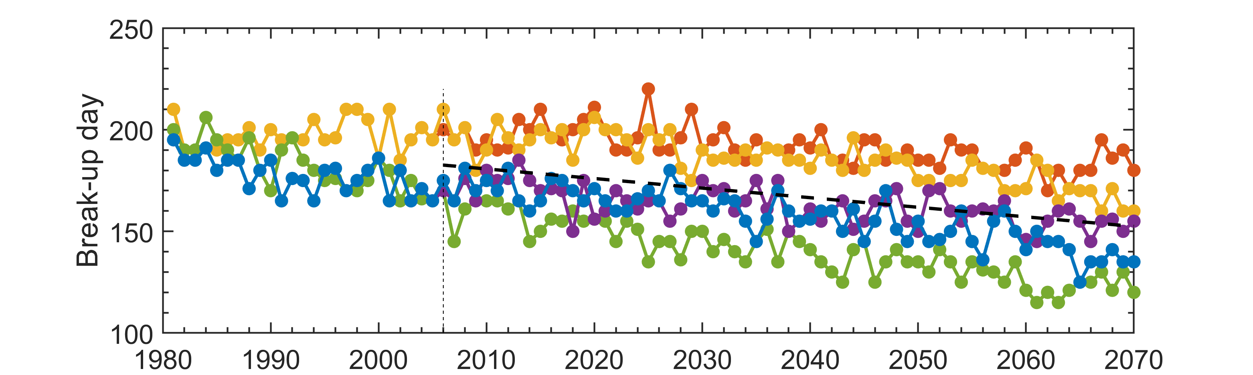
Ensemble mean break-up date occurs early between 2005 – 2070: up to 30 days by 2070
Annual mean break-up date over the Hudson Bay Complex
Naturalized
Little influence from river regulation
2006
Regulated
2006

Slide 25
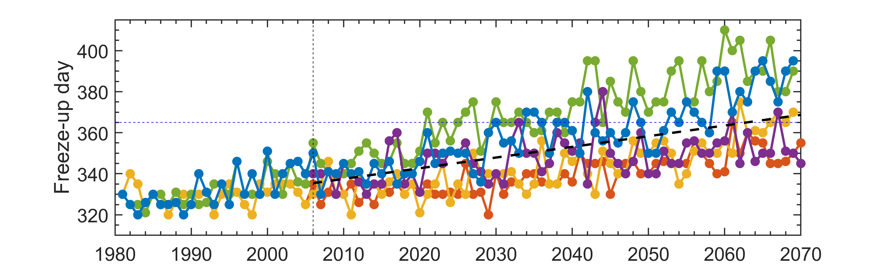
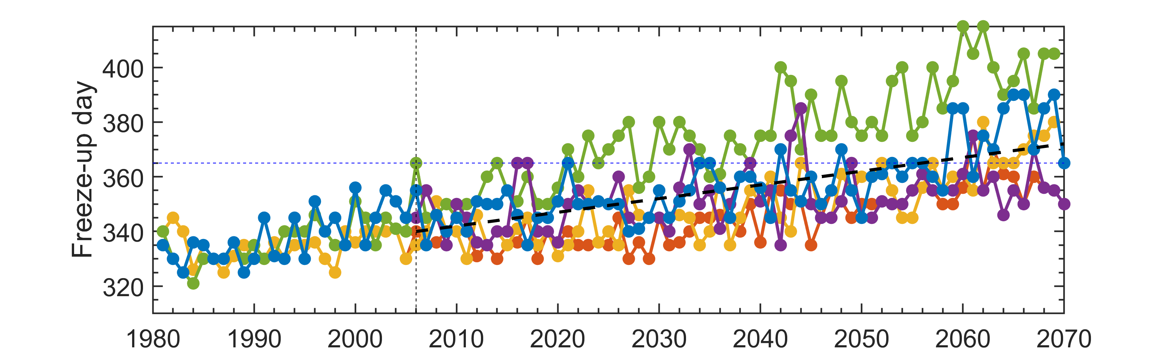
Ensemble mean freeze-up day delays by ~33 days between 2005 - 2070
Annual mean freeze-up date over the Hudson Bay Complex
Naturalized
365
Little influence from river regulation
2006
Regulated
365
2006

Slide 26
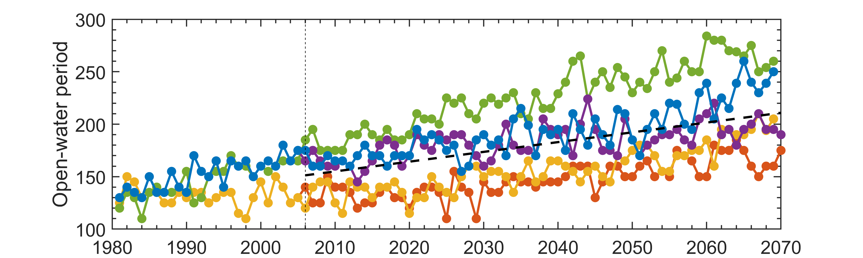
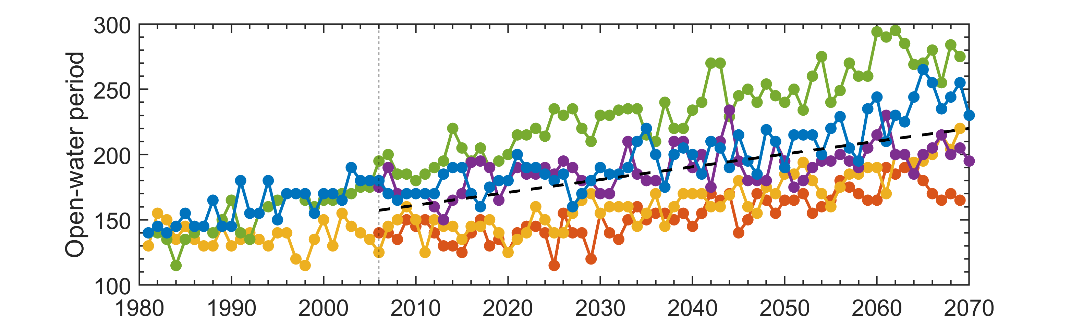
Ensemble mean open water period lengthens by over two months between 2005 - 2070
Annual mean open water period over the Hudson Bay Complex
Naturalized
Little influence from river regulation
2006
Regulated
2006

Slide 27
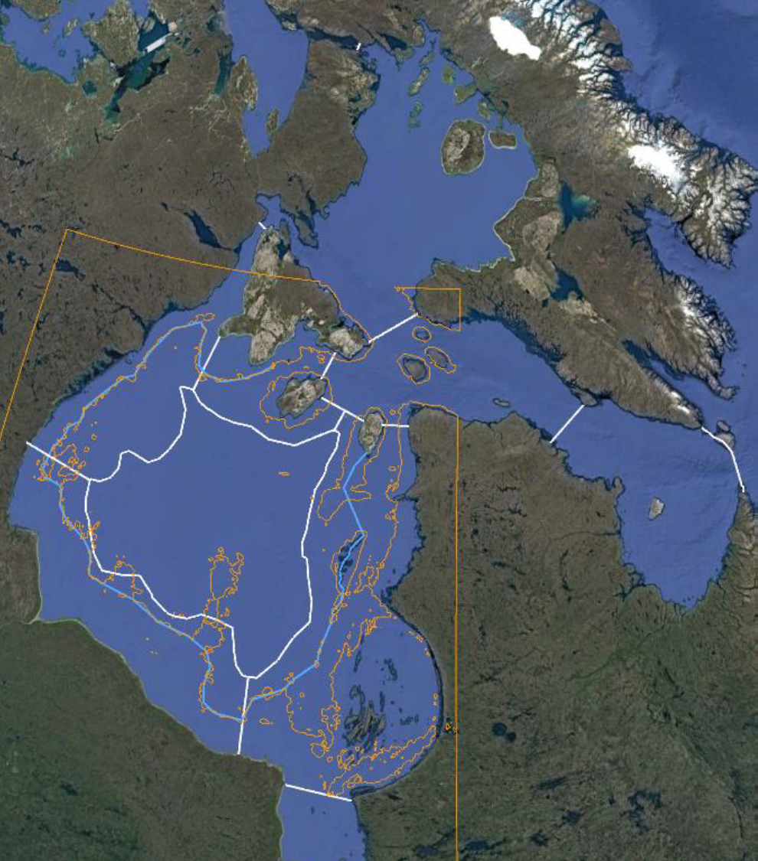
HBC FW Budgets and Marine Exchanges
Greg McCullough
Goals
To quantify FW inventories regionally
Quantify FW and total exchange between major basins
Quantify FW and total exchange between interior and coastal regions, and net flow around the coastal circuit
Quantify vertical exchanges into/below mixed layer
Looking for either/both seasonal or inter-decadal patterns (wet vs dry decades).
Comparison of climate vs regulation impacts on freshwater circulation and budgets, using the same HBC basin boundaries and HB internal region.

Slide 28
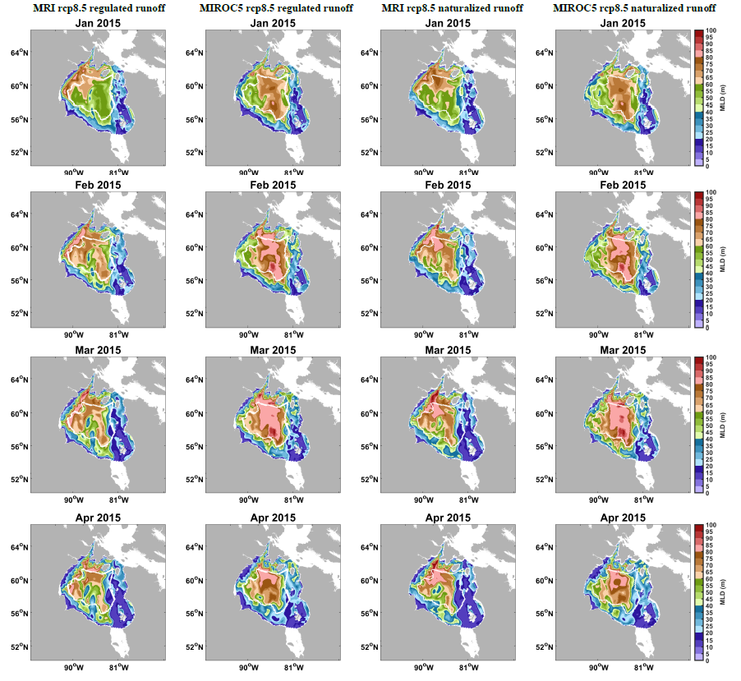
2015 Winter Mixed Layers – Climate Runs

Slide 29
Carbon system response to climate change from BLING in Hudson Bay
Marine productivity increases – Climate driven (likely linked to ice cover changes – regulation has little impact
Bay becomes more acidic – Signal large in naturalized experiments due to seasonality of discharge and HS inflow

